Slide 1
Credit Card Data Analysis
Presented By: Rohan Giri

Slide 2

Introduction
Happy Customer Bank
This is a mid-sized private bank that deals in all kinds of banking products.
Bank wants to cross sell its credit cards to its existing customers. The bank has identified a set of customers that are eligible for taking these credit cards.

Slide 3
Features In Given Data
Categorical
ID
Gender
Region Code
Occupation
Channel Code
Credit Product
Is Active
Is Lead
Numerical
Age
Vintage
Average Account Balance

Slide 4
Total Number Of Customers: 2,45,725
Gender
Male: 1,34,197
Female: 1,11,528
Occupation
Self Employed: 1,00,886
Salaried: 71,999
Other: 70,173
Entrepreneur: 2667
Total Number Of Regions: 35
Number of Active Customers In Last 3 Months: 95,435
Number of Interested Customers For Credit Card: 58,288

Slide 5
Range Of Numerical Features
FEATURE | RANGE
AGE | 23-85
VINTAGE | 7-135 (in months)
AVERAGE ACCOUNT BALANCE | 20,790-1,03,52,009

Slide 6
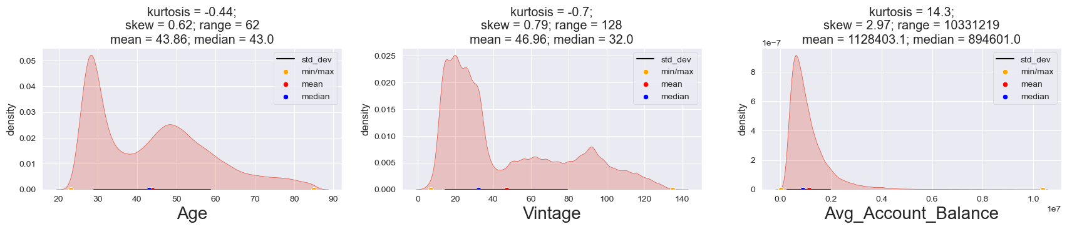
Numerical Features

Slide 7
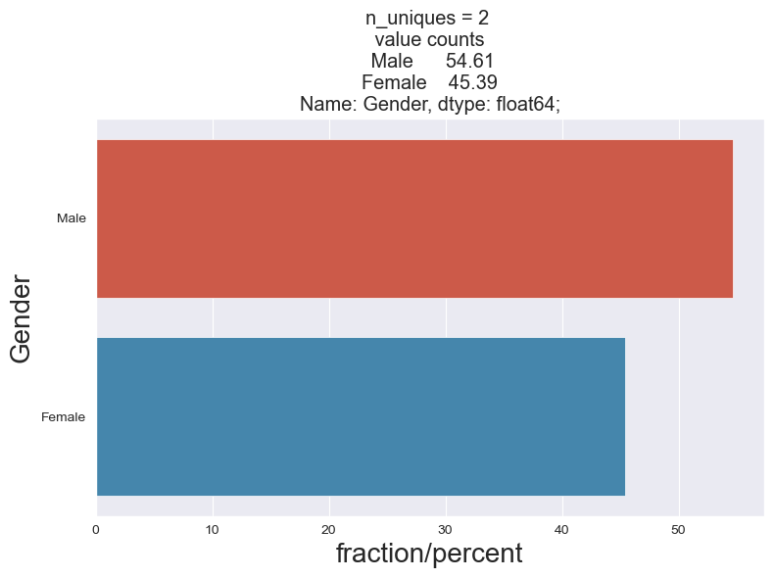
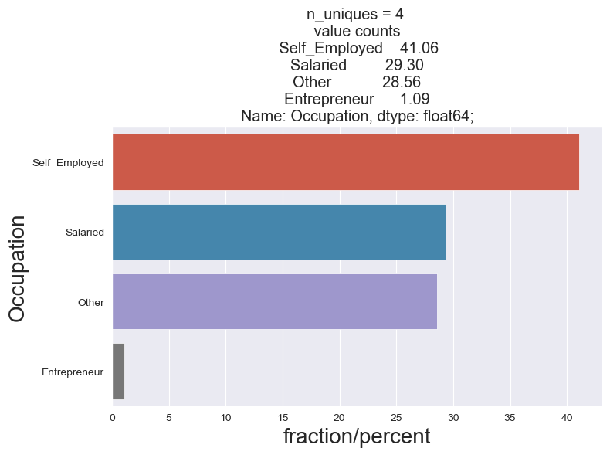
Categorical Features

Slide 8
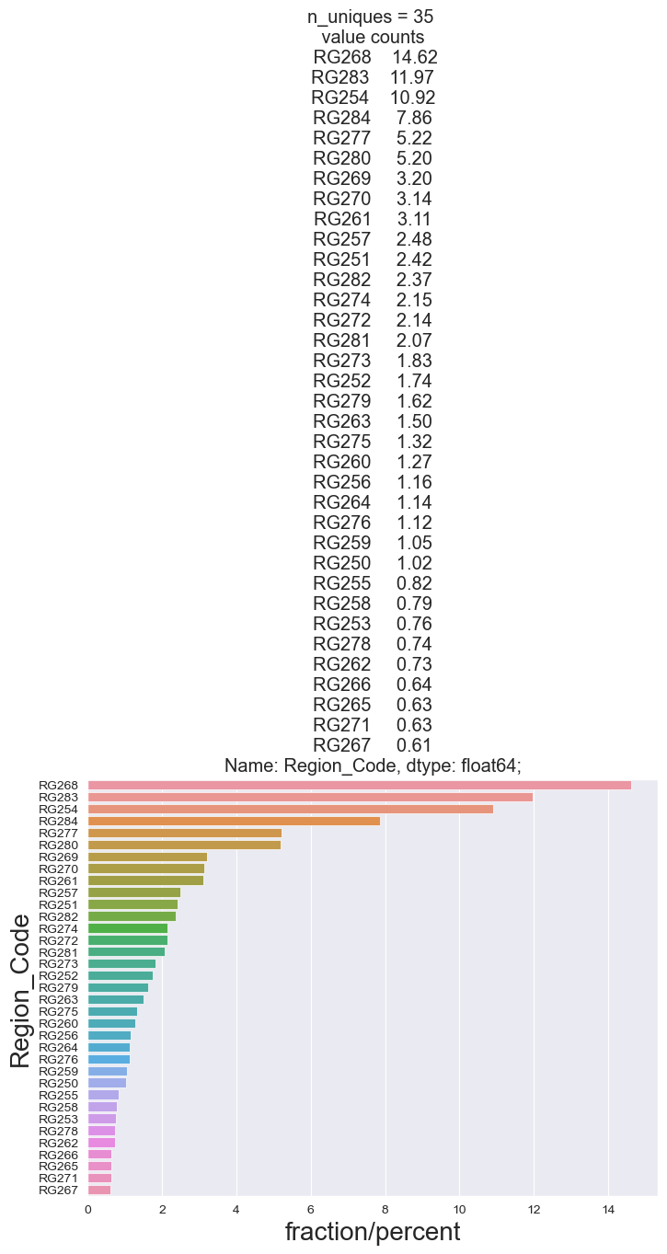

Slide 9
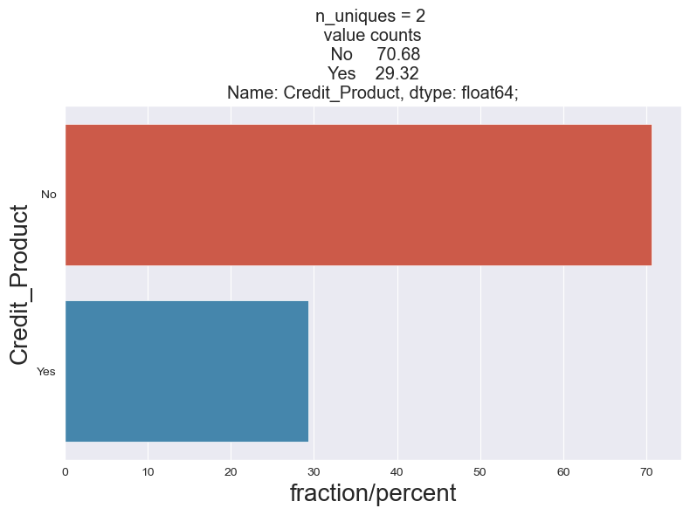
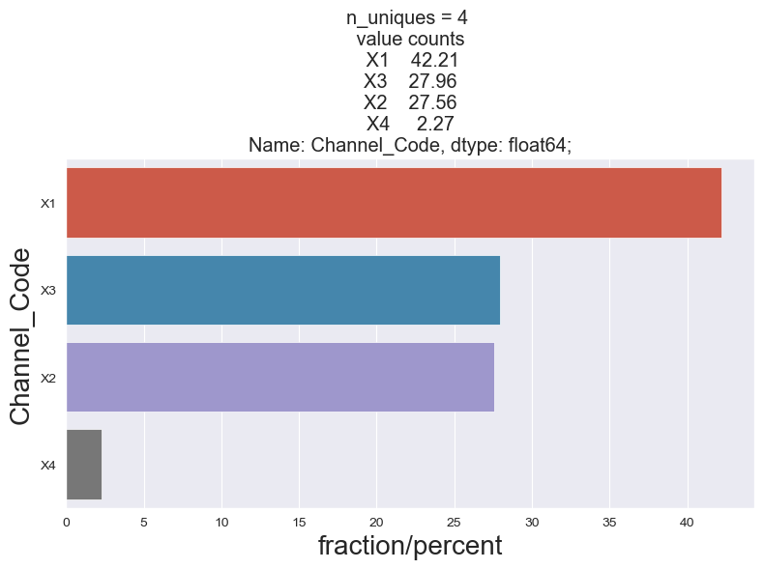
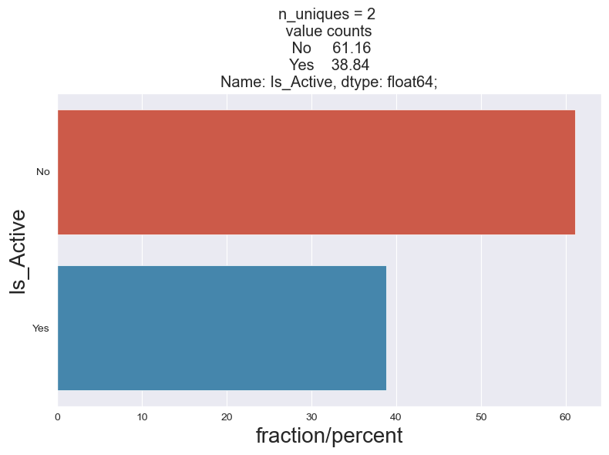
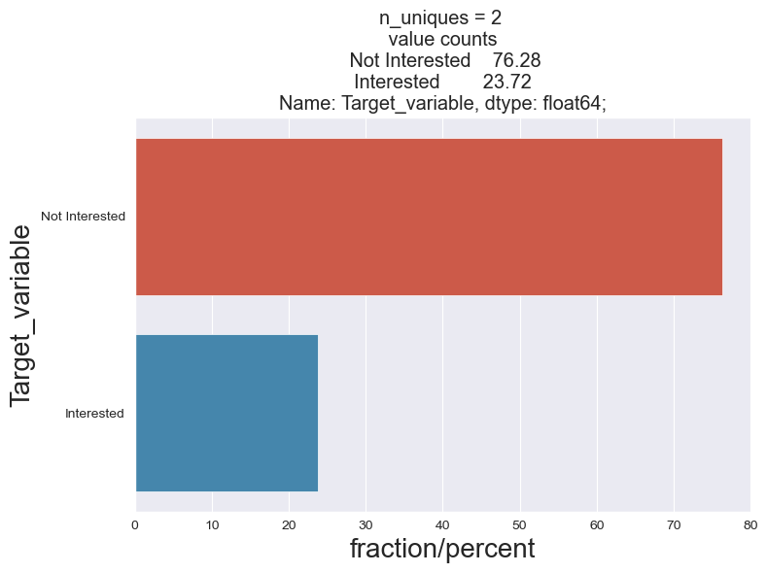

Slide 10
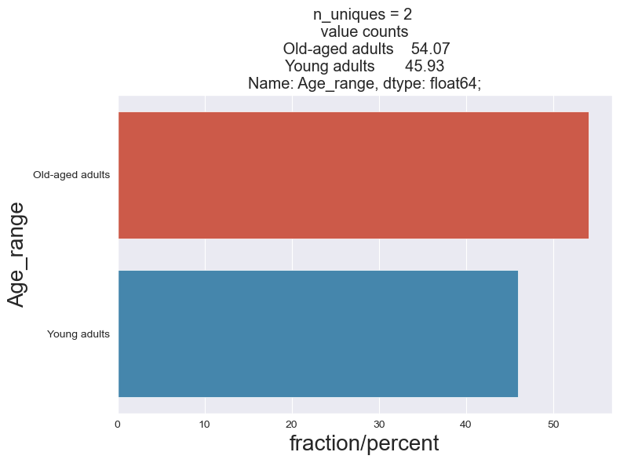
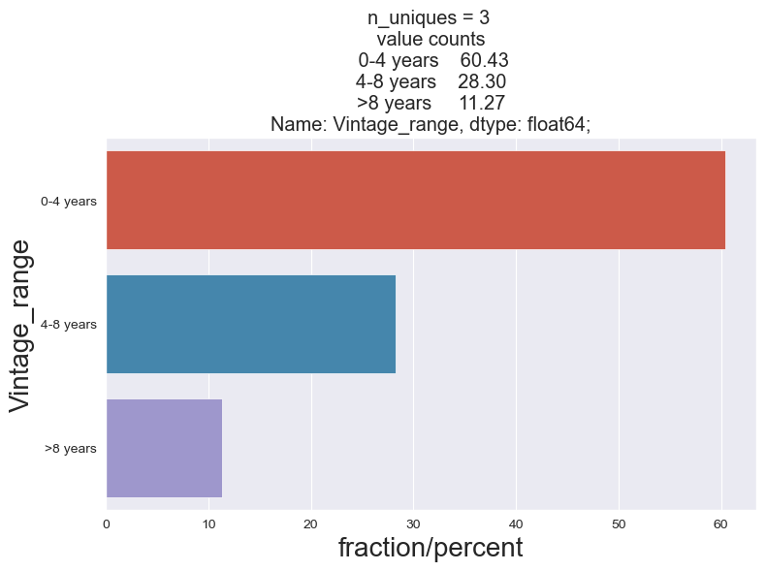
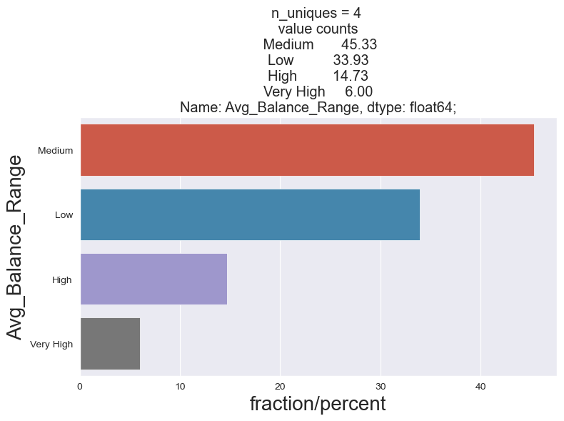

Slide 11
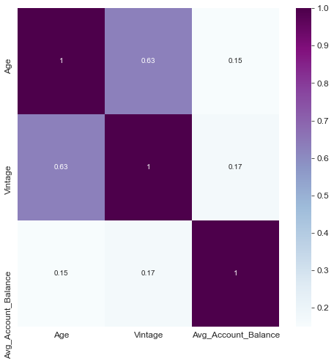
Numerical-Numerical Features

Slide 12
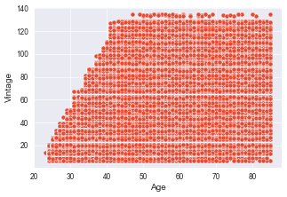
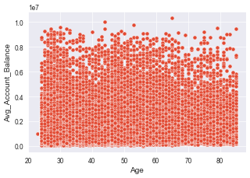
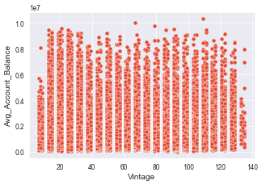

Slide 13
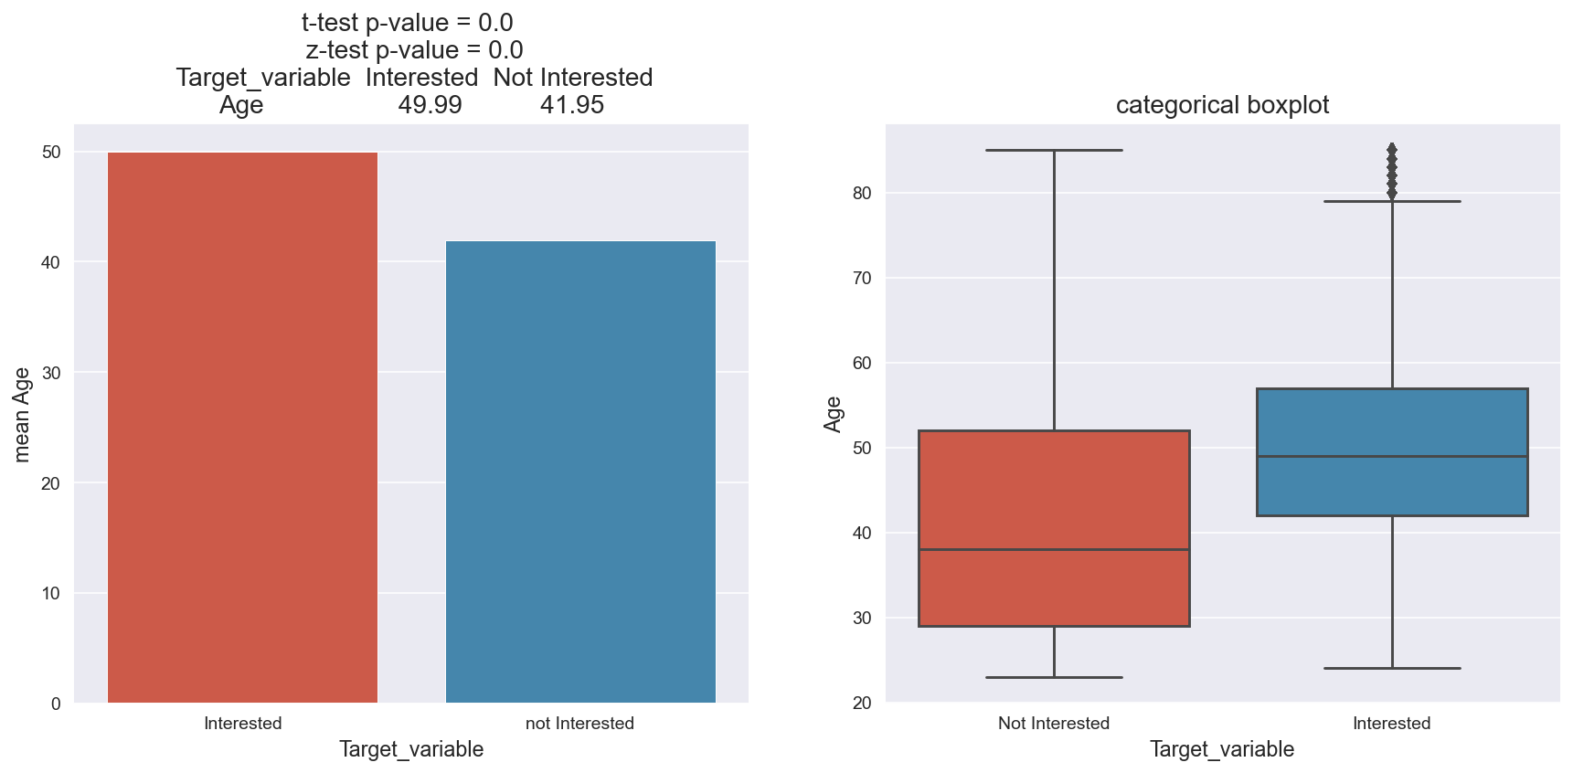
Categorical-Numerical Features

Slide 14
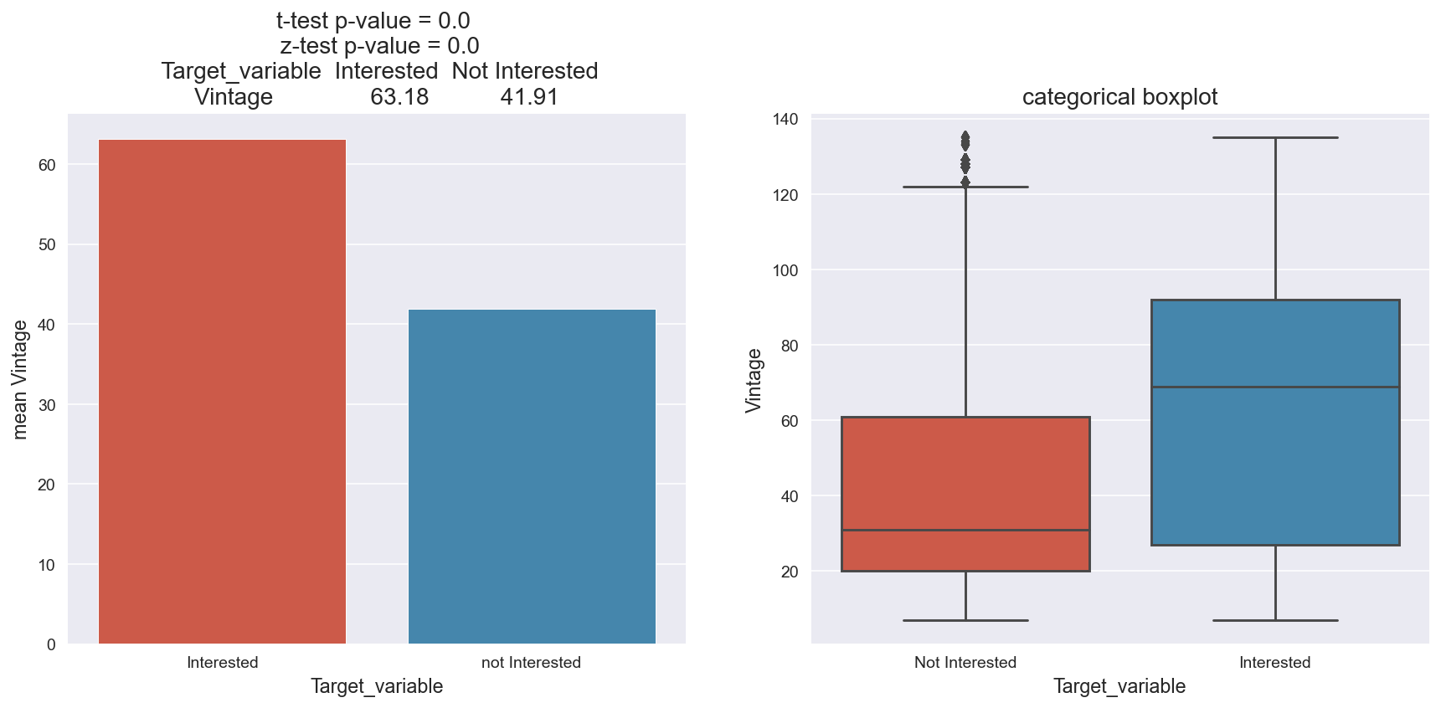
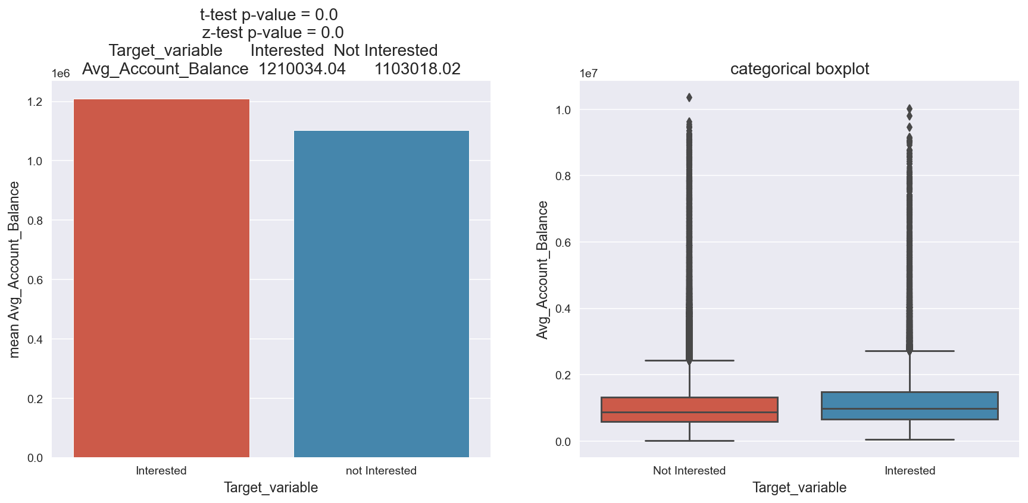

Slide 15
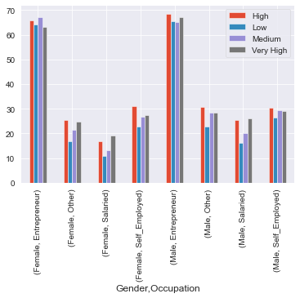
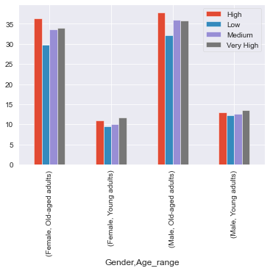

Slide 16
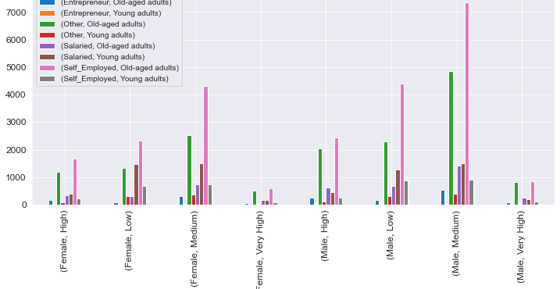

Slide 17

Conclusion
Most of the non active customers are most likely to churn from the bank.
Most of the customers churn after the age of 40.
Number of Interested customers for credit cards are less as most of the customers are planning to churn from the bank.
Old-aged, Self – Employed customer lying in Medium Range of Average Balance Range are more interested for the credit cards.
Young Adults, Females and Entrepreneur are less likely to be interested for credit cards.

Slide 18

Recommendations
Provide missing values of the credit product.
Provide better interest rate and offers to customers whose vintage is more than 4 years.
Bank can do different kinds of communications and campaigns with Female and Young Adults for promotions and offers to attract them.

Slide 19
THANK YOU

Slide 20
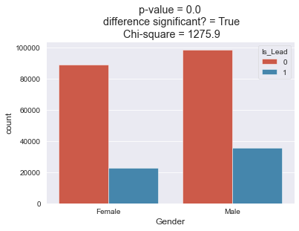
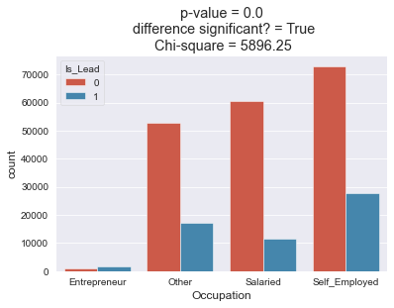
Categorical-Categorical Features

Slide 21
